Slide 1
CSM 491 - Graph Theory and Its Application
Lectures
by
Dr. Oliver Kornyo
Dept. of Computer Science

Slide 2
VECTOR SPACES OF A GRAPH
Lecture Outline
Sets with One Operation
Semi Groups
Binary Operations
Modular Arithmetic and Galois Fields
Basis vectors of a Graph

Slide 3
SETS WITH ONE OPERATION
Set: A set is a collection of objects (called the elements of the set). Note that there is no specification on the nature of the elements or the number of elements. Nor do the elements have anything to do with each other, except belong to the same set. Braces are used to enclose the elements of a set.
For instance, a set S consisting of five objects a, b, c, x, and y may be written as S = {a, b, c, x, y}. Since the order in which these elements appear is of no significance, we could have written the same set as S = {x, b, a, y, c}, for instance. The symbol a ∈ S is used to indicate that element a is in set S.

Slide 4
Subsets
A subset S′ of a set S is a collection of some of the elements of S. If S′ has at least one element that is not in S′ then S” is called a.proper subset of S. The empty set or null set, written ∅, has no element in it and is considered a subset of every set.
The two most common combinations of sets are the union ∪ and intersection ∩, defined as S1 ∪ S3 = S3 , a set containing all the elements of S1 and S2 , S1 ∩ S2 = S4 , a set containing only those elements that are both in S1 and in S2 .

Slide 5
Operations
Operation: Let us introduce a rule of combination called binary operation (also called binary composition, law of composition, or internal law of composition) between two elements of a set. Addition, multiplication, subtraction, and division are some of the familiar binary operations between two elements in a set of numbers.
To keep the binary operation general enough, we shall use the symbol * (rather than using +, −, ×, ÷, etc.) to denote the binary operation. A set with operations defined on it is called an algebraic system or just algebra

Slide 6
Special Types of Algebras
Now we have a set, say S = {a, b, c, . . .}, and a binary operation * (written as a * b) between the elements of S. Depending on the nature of the binary operation *, set S can be classified as one of several special types of algebras.
For instance, if * satisfies postulates 1 and 2 below, set S is called a semigroup:
1. Closure: If a and b are in S, then a * b is also in S.
2. Associative: If the elements a, b, and c are in S, then (a * b) * c = a * (b * c).

Slide 7
Semi-Groups
A semigroup that satisfies postulate 3, below, is called a monoid.
3. Identity element: There exists a unique element e in S such that for any element x in S, x * e = e * x = x. A monoid that satisfies postulate 4, below, is called a group.
4. Inverse: For every element x in S there exists a unique element x′ in S such that x * x′ = x′ * x = e. Element x′ is called the inverse of x, with respect to operation *. A semigroup that satisfies postulate 5, below, is called an abelian semigroup or commutative semigroup.
5. Commutative: If a and b are in S, then a * b = b * a.

Slide 8
SETS WITH TWO OPERATIONS
6. Closure: If a and b are in S, then a ⊙ b is also in 5.
7. Associative: If a, b, and c are in S, then (a ⊙ b) ⊙ c = a ⊙ (b ⊙ c).
8. Identity element: There exists a unique element i in S such that for any element x in S, x ⊙ i = i ⊙ x = x. This element i is called the identity element (or unity) with respect to operation ⊙.
9. Inverse: For every element (except for the identity element e of postulate 3 in Section 6-1) x in S, there exists a unique element x −1 in S such that x ⊙ x −1 = x −1 ⊙ x = i. Element x −1 is called the inverse of x, with respect to operation ⊙.
10. Commutative: If a and b are in S, then a ⊙ b = b ⊙ a.

Slide 9
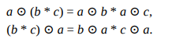
BINARY OPERATIONS
Distributive: The operation ⊙ is distributive with respect to the operation * ; that is, for elements a, b, and c in S

Slide 10
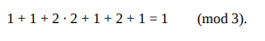
MODULAR ARITHMETIC AND GALOIS FIELDS
Consider a system of numbers that has only three numbers in it, ordinary 0, 1, and 2. And let the rules for addition and multiplication in this system be the same as ordinary addition and multiplication with the following exception:
If a number q (resulting from addition or multiplication operations) equals or exceeds 3, it is to be divided by 3, the quotient is discarded, and the remainder is used in place of q.
The addition and multiplication tables for such a number system are given in Fig. 6-3, and are called addition modulo 3 and multiplication modulo 3. Together they are called modulo 3 arithmetic. For example, in modulo 3 arithmetic,

Slide 11
Finite Fields
From the tables in Fig. 6-3, it can be verified that the set {0, 1, 2} with addition and multiplication modulo 3 is a field. There is an identity 0 with respect to modulo 3 addition, and an identity 1 with respect to modulo 3 multiplication. Every element has a unique additive inverse, and every element other than 0 has a multiplicative inverse.
By means of actual tables, like those in Fig. 6-3, it can be easily verified that modulo 2, 5, and 7 systems are also fields. On the other hand, the set {0, 1, 2, 3} with modulo 4 addition and multiplication is not a field, because no inverse of 2 exists with respect to modulo 4 multiplication

Slide 12
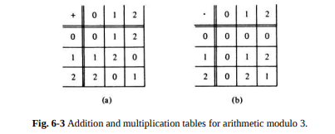
Arithmetic Modulo 3

Slide 13
Galois Field
In fact, it turns out that every finite set
Zm = {0, 1, 2, . . . , m − 1}
with modulo m addition and multiplication is a field if and only if m is a prime number. Such a field is called a Galois field modulo m, or GF(m). As we shall see shortly, in representing graphs we are concerned only with GF(2), Galois field modulo 2. It consists of {0, 1} and the addition modulo 2 and multiplication modulo 2 operations.

Slide 14
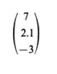
VECTORS AND VECTOR SPACES
In an ordinary two-dimensional (Euclidean) plane, a point is represented by an ordered pair of numbers X = (x1 , x2 ). Point X can also be regarded as a vector emanating from the origin 0 = (0, 0) to the point (x1 , x2 ).
Similarly, in threedimensional Euclidean space the triplet (7, 2.1, − 3) represents a vector. Sometimes, instead of row notation a column notation is used, for example,

Slide 15
Vector Space
A k-dimensional vector space (or a linear vector space) over the field F, is an object consisting of
1. A field F (with its set of elements S, and two operations * and ⊙).
2. A set W of k-tuples (all numbers taken from F).
3. A binary operation ⊞ (called vector sum) between the elements of the set W, such that W is an abelian group under this operation ⊞

Slide 16
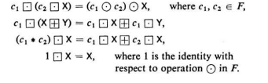
Binary Operation in vectors
A binary operation ⊡ (called scalar multiplication), which when applied between any scalar c in F and a vector X = (xl , x2 , . . . , xk ) in W produces another vector P in W. P is called the scalar product of c and X, and is given by
Furthermore, scalar multiplication satisfies the following:

Slide 17
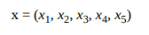
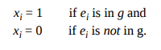
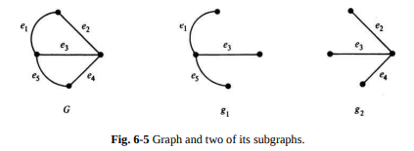
VECTOR SPACE ASSOCIATED WITH A GRAPH
Let us consider the graph G in Fig. 6-5 with four vertices and five edges e1 , e2 , e3 , e4 ,e5 . Any subset of these five edges (i.e., any subgraph g) of G can be represented by a 5-tuple:
Such that
For instance, the subgraph g1 in Fig. 6-5 will be represented by (1, 0, 1, 0, 1).

Slide 18
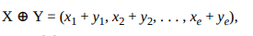
There is a vector space WG associated with every graph G, and this vector space consists of
1. Galois field modulo 2 ; that is, set {1, 0} with operation addition modulo 2 written as + such that 0 + 0 = 0, 1 + 0 = 1 = 0 + 1, 1 + 1 = 0, and multiplication modulo 2 written as · such that 0·0 = 0 = 1·0 = 0·1, and 1·1 = 1.
2. 2e vectors (e-tuples), where e is the number of edges in G. 3. An addition operation between two vectors X, Y in this space, defined as the vector sum being addition modulo 2.
And a scalar multiplication between a scalar c in Z2 and a vector X, defined as c·X = (c·x1 , . . . , c·xe ).

Slide 19
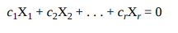
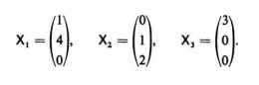
BASIS VECTORS OF A GRAPH
Linear Dependence: A set of vectors X1 , X2 , . . ., Xr (over some field F) is said to be linearly independent if for scalars c1 , c2 , . . . , cr in F the expression
holds only if c1 = c2 = . . . = cr = 0. Otherwise, the set of vectors is said to be linearly dependent. For example, consider the set of three vectors, over the field of real numbers :

Slide 20
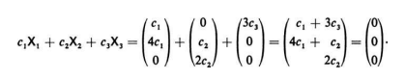
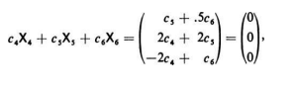
BASIS VECTORS OF A GRAPH
An arbitrary linear combination of these three vectors set to zero gives
That is, 2c2 = 0, 4c1 + c2 = 0, and c1 + 3c3 = 0, which hold only if c1 = c2 = c3 = 0. Thus the set of vectors {X1 , X2 , X3} is linearly independent. On the other hand, consider another set of vectors (over the same field of real numbers) :
Setting an arbitrary linear combination of these vectors to zero,

Slide 21
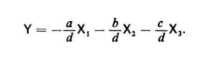
Basis Vectors
To the set of three linearly independent vectors {X1 , X2 , X3} in the first example, let us add another vector Now you can show without much difficulty that the set {X1 , X2 , X3 , Y} is linearly dependent regardless of what Y is. In other words, you can find a set of four real numbers a, b, c, and d (not all of which are zero) such that

Slide 22
Assignment 6
Given a set {a, b, c, d} of four elements, construct two four by four tables for operations * and ⊙, such that the set is a field. Identify the letters playing the roles of identities with respect to * and ⊙ (i.e., 0 and 1).

Slide 23
THANK YOU

